Slide 1
Olympic Games Historical Analytics Using SQL & Interactive Power BI Dashboard
A Comprehensive Historical Analysis of Games, Athletes, and Medals
Presenter: Smruti Ranjan Pradhan

Slide 2
Problem Statement & Scope
• Objective: Gain valuable insights into historical Olympic data by exploring games, sports, events, participants, medals, and regional representation.
• Scope: Analyze data from multiple editions to identify trends, patterns, and significant insights.
• Primary Goal: Provide a detailed overview of the Olympics' history and evolution.
• Deliverable: Comprehensive report and presentation showcasing findings and recommendations to enhance future Olympics' organization, sports selection, and regional representation.

Slide 3
Dataset Description: Table Explanations
• Sport Table: Comprehensive list of all sports (Summer/Winter), categorized into events.
• Event Table: Detailed event info, categorized by gender (Men's, Women's, Mixed).
• City Table: Cities that have hosted or participated in the Olympics.
• Games Table: Records every instance since 1896 (Year, Season).
• Games City Table: Joining table for Games and Cities (e.g., 1956 Melbourne/Stockholm).
• NOC Region Table: NOC codes mapped to participating countries.
• Person Table: Competitor info (Name, Gender, Height, Weight).
• Person Region Table: Links individuals to represented countries (accommodates country changes).
• Games Competitor Table: Links individuals to specific Olympic Games.
• Medal Table: Medal types (Gold, Silver, Bronze, N/A).
• Competitor Event Table: Largest table; links competitors, events, and medals.

Slide 4
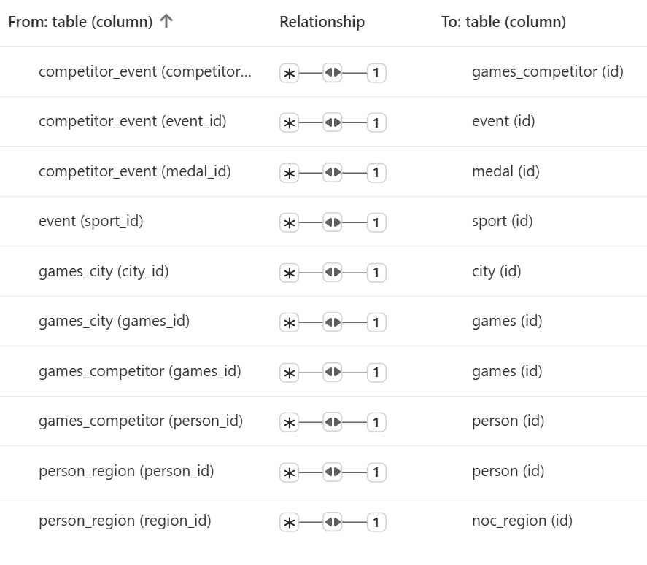
Entity-Relationship (ER) Diagram
• The database structure is established through an Entity-Relationship Diagram (ERD).
• Cardinality and table relations are defined as 1-to-Many or Many-to-1.
• Cross filter directions are configured for better understanding of table structures and their relationships.

Slide 5
MECE Breakdown of Analysis Areas
1. Games Evolution: Growth, editions, host cities, expansion.
2. Sports & Events: Structure, diversity, new/discontinued, gender events.
3. Athlete Demographics: Gender, age, height, weight, participation trends.
4. Country Performance: Country-wise participation, success, dominance.
5. Medal Analysis: Distribution patterns across countries, sports, genders.
6. Geographic/Host Analysis: Hosting patterns, regional representation.
7. Participation vs Performance: Athlete volume vs. medal efficiency.
8. Gender & Diversity: Inclusion trends, male/female/mixed representation.
9. Historical Trends: Long-term changes in participation and sports growth.
10. Predictive Insights: Future-oriented observations using historical data.

Slide 6
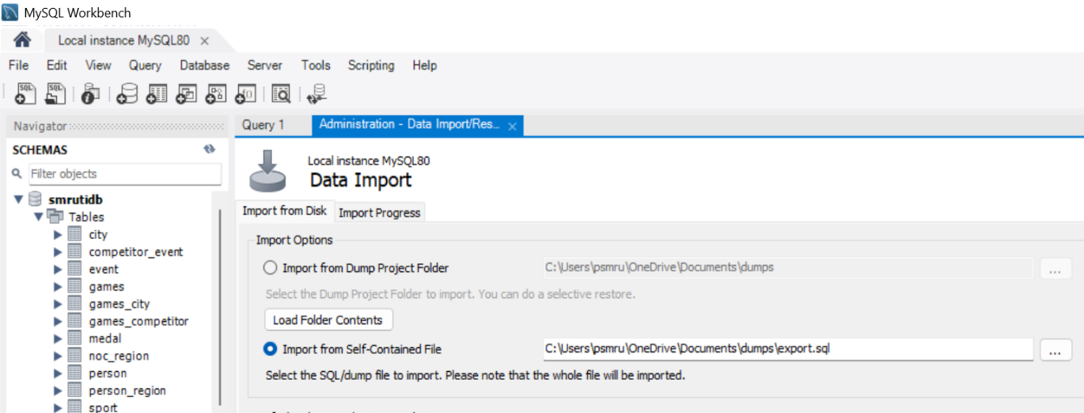
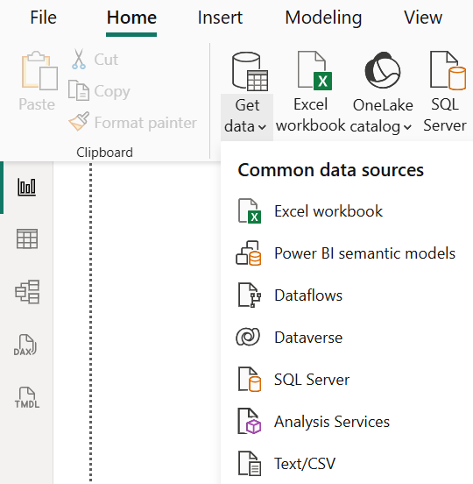
Data Connection and Access
• MySQL Workbench (SQL Analysis):
- Path: Server > Import Data > Import From Self Contained File.
- Imported SQL scripts of the whole dataset.
• Power BI Dashboard:
- Path: Get Data > Text/CSV.
- Imported CSV files for visual analysis.

Slide 7
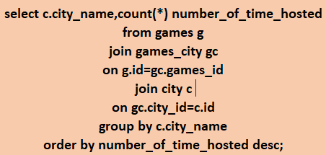
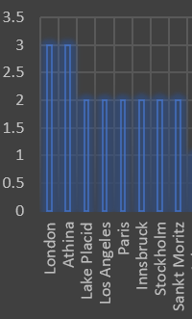
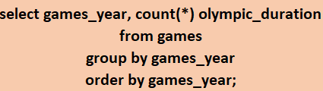
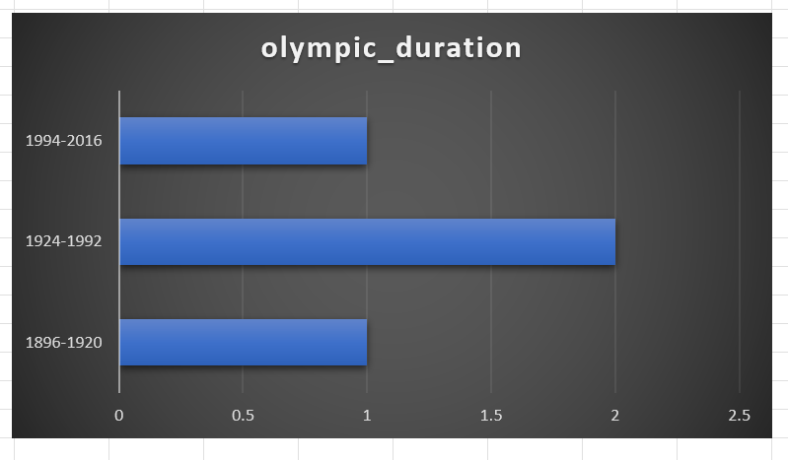
EDA: Games & Hosting Trends (MySQL)
1. Frequency of Hosting:
• London and Athina hosted max times (3 each).
• Lake Placid, Los Angeles, Paris, Innsbruck, Stockholm, Sankt Moritz hosted 2 times.
2. Duration of Games Over Time:
• 1896-1920 & 1994-2016: Single editions held.
• 1924-1992: Two Olympic events were held (Summer & Winter in same year).

Slide 8
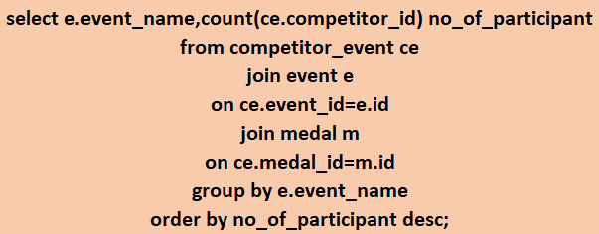
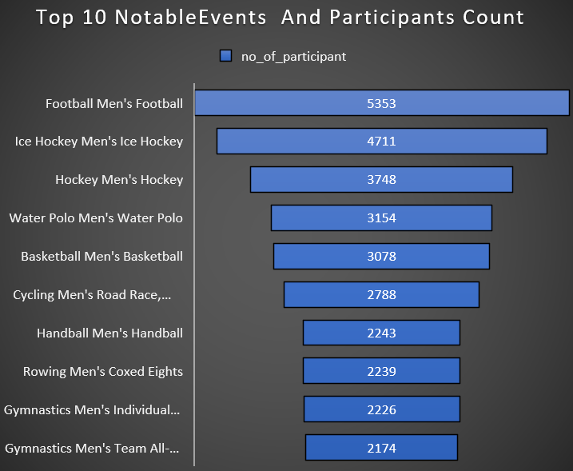
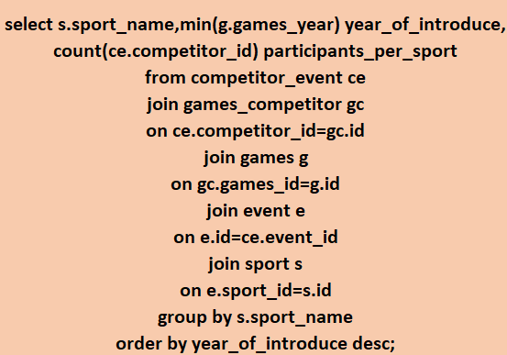
EDA: Notable & Emerging Events (MySQL)
3. Notable Events (Highest Participants):
• Men's Football (5353), Men's Ice Hockey (4711), Men's Hockey (3748).
• Low participation: Gymnastic Men’s Individual/Team (~2200).
4. Emerging Sports:
• Rugby Sevens introduced recently with ~300 participants across multiple events.

Slide 9
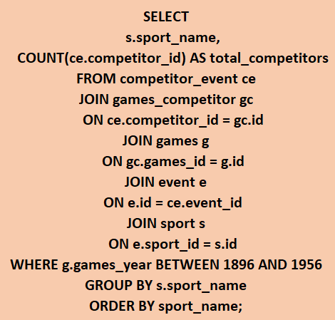
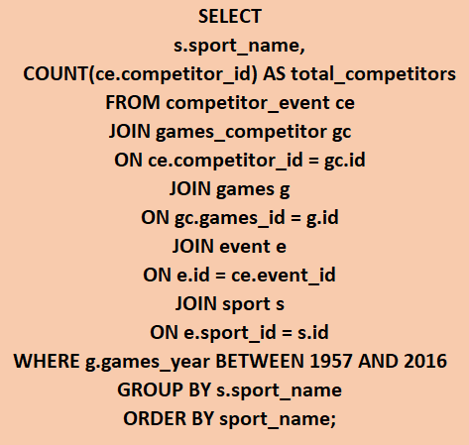
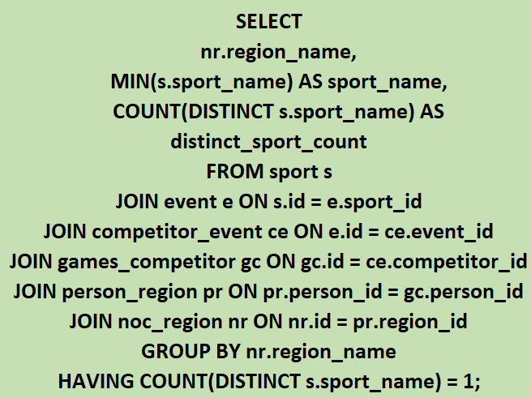
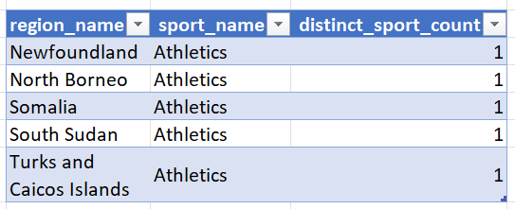
EDA: Popularity Changes & Regional Sports (MySQL)
5. Sports that Lost Popularity (Significant drop 1896-1956 vs 1957-2016):
• Aeronautics, Alpinism, Art Competitions, Basque Pelota, Cricket, Croquet, Jeu De Paume, Lacrosse, Military Ski Patrol, Motorboating, Polo, Racquets, Roque, Rugby, Tug-Of-War.
6. Region/Culture-Specific Sports:
• Athletics is uniquely associated with Newfoundland, North Borneo, Somalia, South Sudan, and Turks & Caicos Islands (distinct sport count = 1).

Slide 10
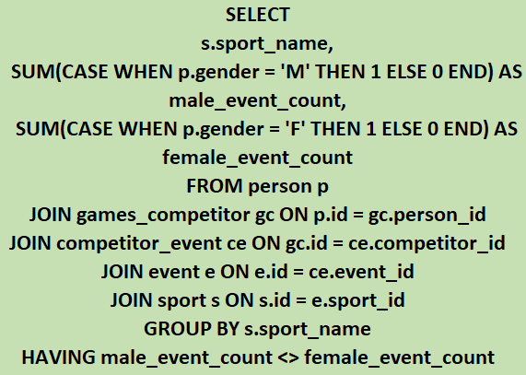
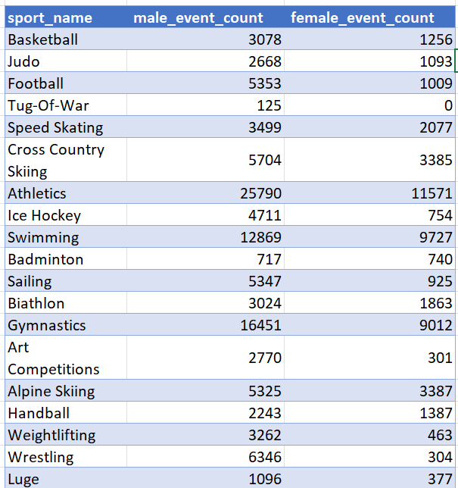
EDA: Gender Disparity in Sports (MySQL)
7. Sports with higher events for one gender:
• Significant male dominance: Football (5353 M vs 1009 F), Ice Hockey (4711 M vs 754 F), Wrestling (6346 M vs 304 F), Boxing (5648 M vs 72 F).
• Female-only dominance: Softball (0 M vs 478 F), Rhythmic Gymnastics (0 M vs 658 F), Synchronized Swimming (0 M vs 903 F).
• Male-only historical: Tug-Of-War, Nordic Combined, Baseball, Lacrosse, Polo, Cricket, Racquets.

Slide 11
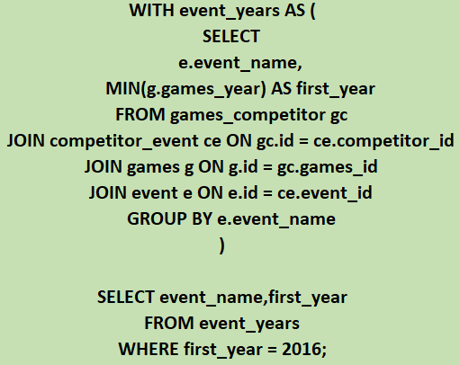
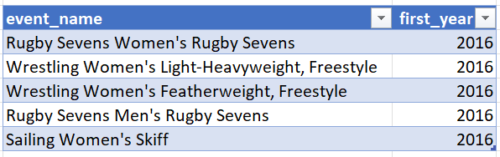
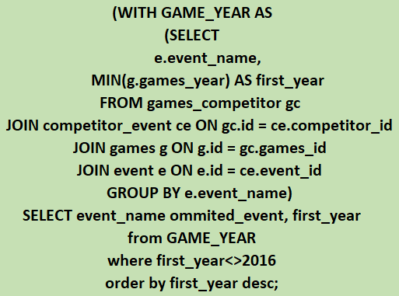
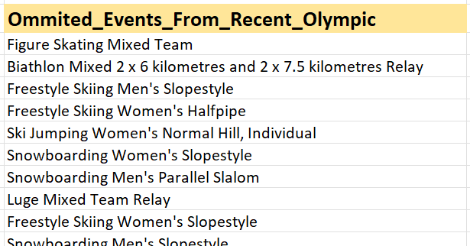
EDA: New & Discontinued Events (MySQL)
8. Newly Introduced Events (Recent Editions):
• Rugby Sevens (Women's & Men's), Wrestling Women's Light-Heavyweight/Featherweight Freestyle, Sailing Women's Skiffs.
9. Discontinued/Removed Events:
• Multiple events omitted from recent editions.
• Methodology: CTE used to extract event names not present in recent games.

Slide 12
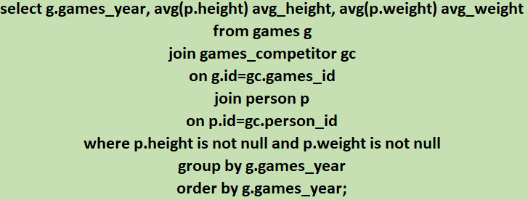
EDA: Athlete Demographics - Height & Weight (MySQL)
10. Trends in Height and Weight Over Time:
• Both average height and weight show a clear upward trend over time.
• Dotted trendlines confirm a positive linear progression.
• Athletes have generally become taller and heavier over the decades (e.g., avg height/weight jumped significantly from the 1960s onwards).

Slide 13
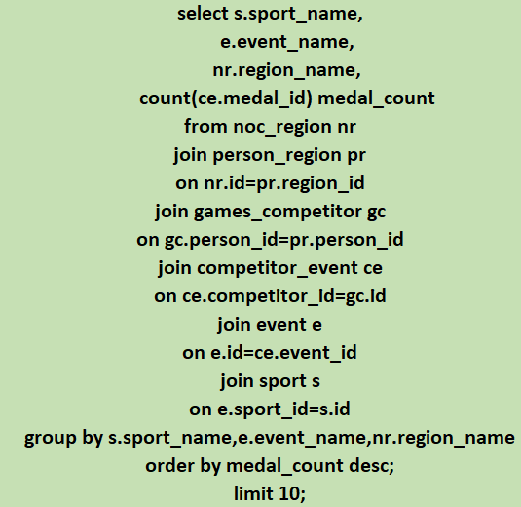
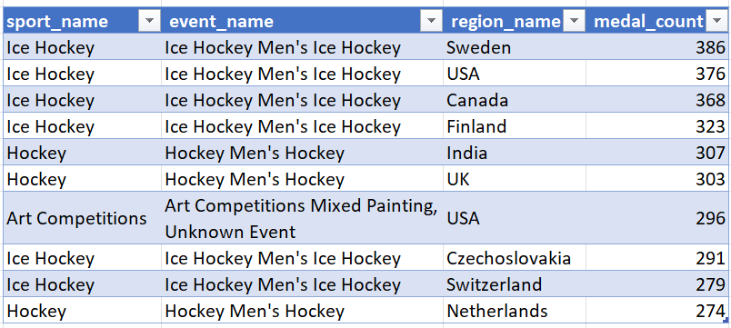
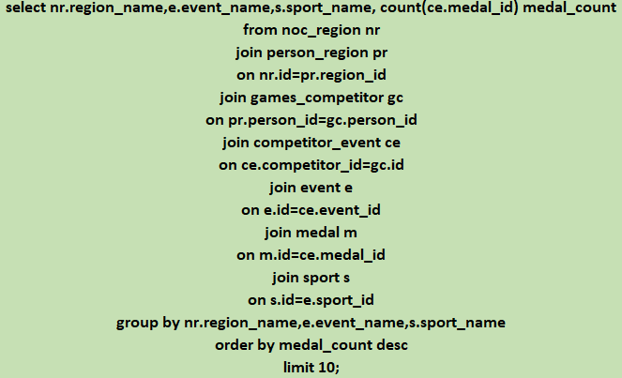
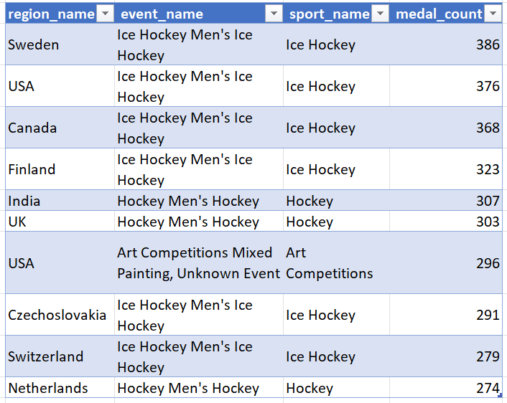
EDA: Country Dominance in Specific Sports (MySQL)
11. Dominant Countries in Specific Sports:
• Sweden: Ice Hockey (386 medals)
• USA: Ice Hockey (376) & Art Competitions (296)
• India: Men's Hockey (307 medals) • Finland: Ice Hockey (323)
14. High medal counts from Specific Regions:
• Men's Ice Hockey dominated by Sweden, USA, Canada, Finland, Czechoslovakia, Switzerland.

Slide 14
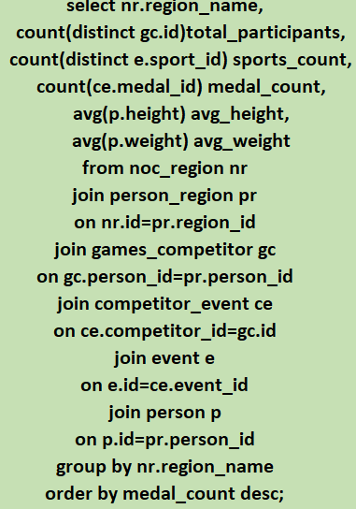
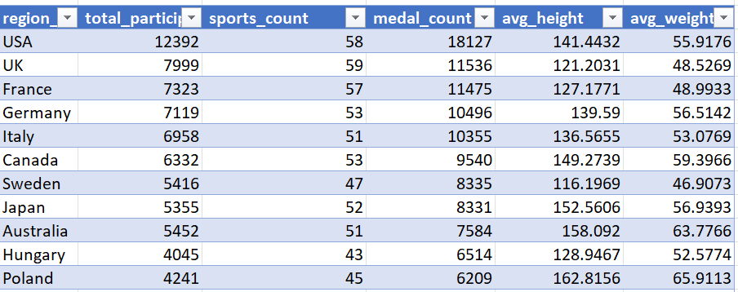
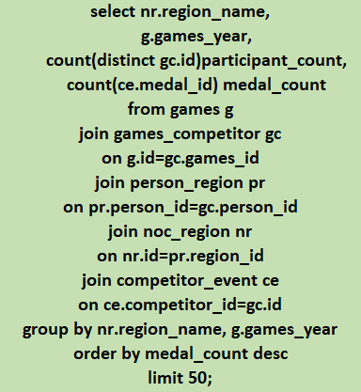
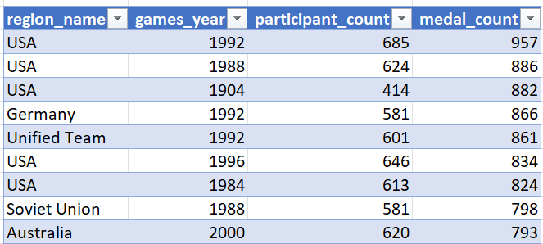
EDA: Success Factors & Consistent Performers (MySQL)
12. Factors Contributing to Success:
• Larger delegations = more medals overall; smaller nations = higher efficiency (medals/athlete).
• Sport diversity increases opportunities. Physical attributes show limited direct correlation vs. strategic focus.
13. Consistently Performing Countries:
• USA tops the list (max medals across multiple editions, e.g., 957 in 1992, 886 in 1988).
• Germany, UK, and Russia/Soviet Union also perform consistently well across decades.

Slide 15
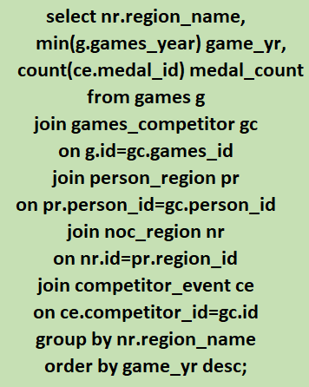
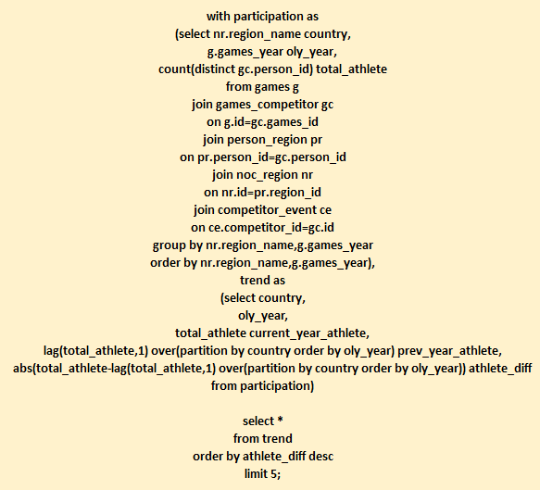
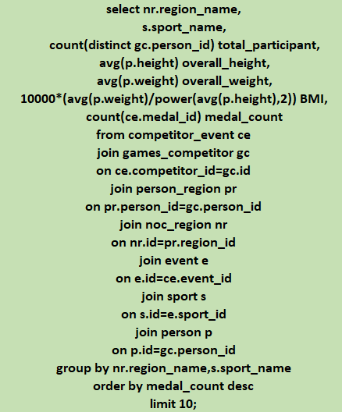
EDA: Surprises, Growth & Geographic Factors (MySQL)
15. Surprising Medal Wins: Refugee Olympic Team participated 1st time recently and grabbed 12 medals.
16. Significant Growth/Decline: Australia, Unified Team, USA, China experienced notable changes in athlete participation count consecutively (Tracked via SQL LAG() window function).
17. Cultural/Geographical Factors: Countries with high participant counts AND good physical balance (BMI) grabbed max medals (USA, UK, France, Germany, Italy, Australia).

Slide 16
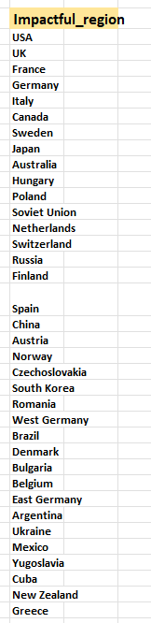
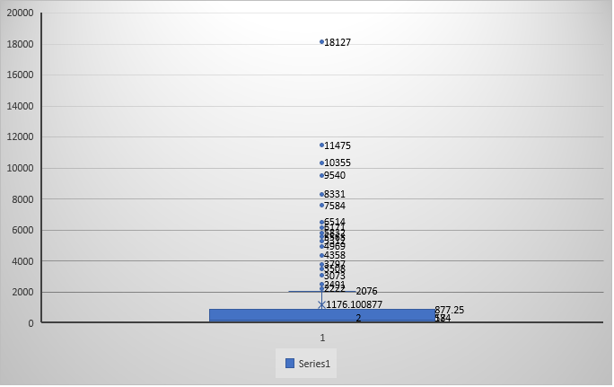
EDA: Impact on Overall Medal Tally (MySQL)
18. Regions with Notable Impact on Medal Tally:
• Created a box plot to identify outliers impacting the overall tally.
• Found 36 data points (countries) considered as outliers.
• Major impactful regions: USA, UK, France, Germany, Italy, Soviet Union, China, Australia, and 28 others.

Slide 17




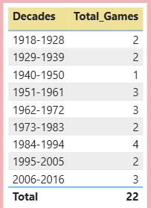




Power BI: Games & Season Overview
1. Summer vs Winter Games: 29 Summer vs 22 Winter games (KPI Card + Slicer).
2. Games Across Decades: Grouped games year by decade, displayed in a simple table visual.
4. Sports Distribution: 52 Summer sports vs 17 Winter sports (KPI Card + Season Slicer).

Slide 18
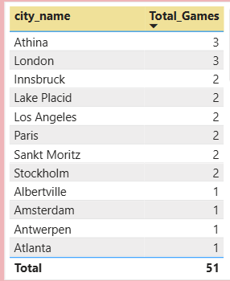
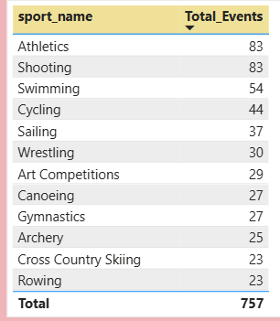

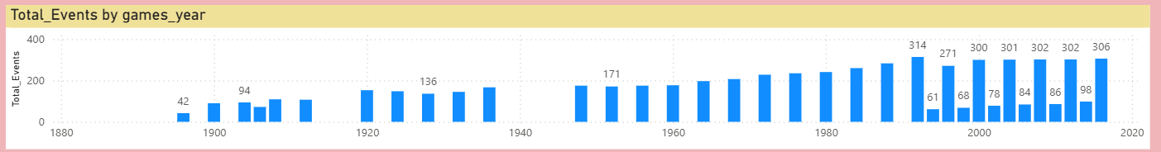
Power BI: Host Cities & Sports/Events
3. Top Host Cities: Table visual sorted descending by Total Games measure.
5. Highest Events by Sport: Athletics has the highest number of events (Table visual with Total Event measure).
7. Events Per Sport: Simple table visual mapping Sports Name to Total Event measure.
9. Events Over Time: Column chart visualizing Total Event measure by Games Year.

Slide 19
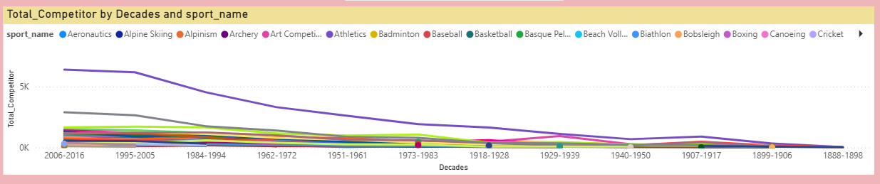
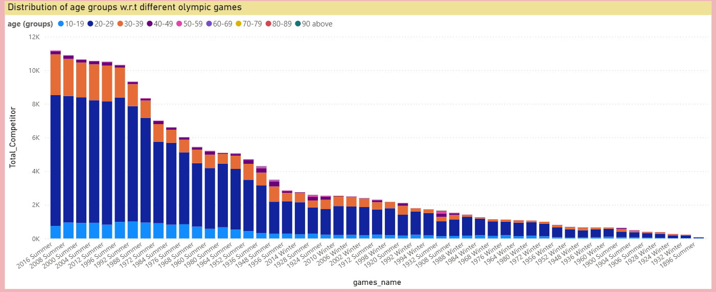






Power BI: Participation & Gender Diversity
6. Sport Evolution Over Time: Line chart with Total Competitors (Y), Decade (X), Sport Name (Legend).
8. Events by Gender: 268 Female events vs 546 Male events (KPI Card + Gender Slicer).
10. Participants by Gender: 48,000 Female vs 132,000 Male participants (KPI Card + Gender Slicer).
12. Age Distribution: Clustered column chart (Total Participants by Game Name, legend = Age Group 10-19, 20-29, 30-39).

Slide 20
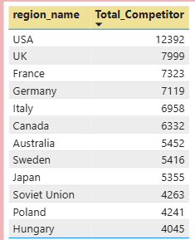
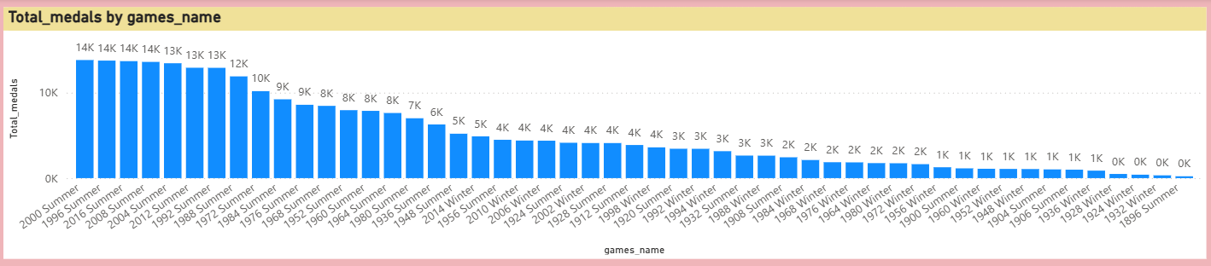
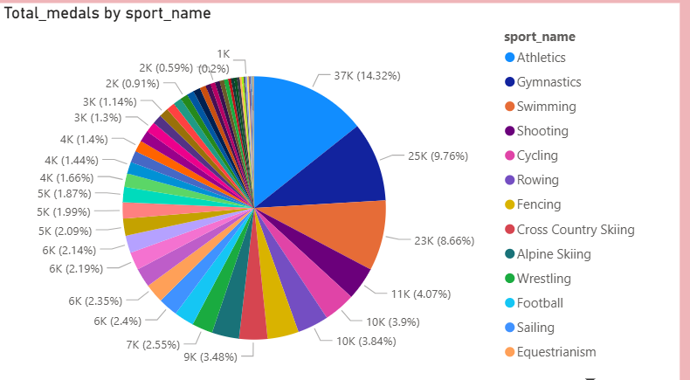
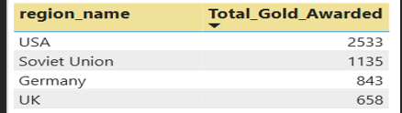
Power BI: Country Performance & Medals
11. Highest Participants by Country: USA leads with 12,392 participants (Table visual).
13. Medals Per Olympics: Column chart with data labels enabled (Total Medals by Games Name).
14. Highest Gold Medals: USA received the highest gold medals (2,533) (Table visual with Total Gold Awarded measure).
15. Medals by Sport: Pie chart showing Total Medal distribution across Sport Names.

Slide 21
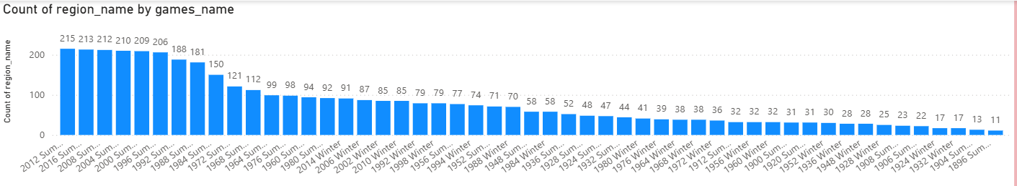
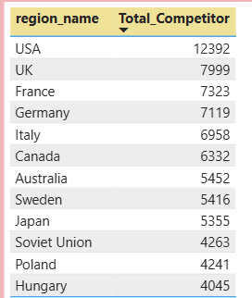
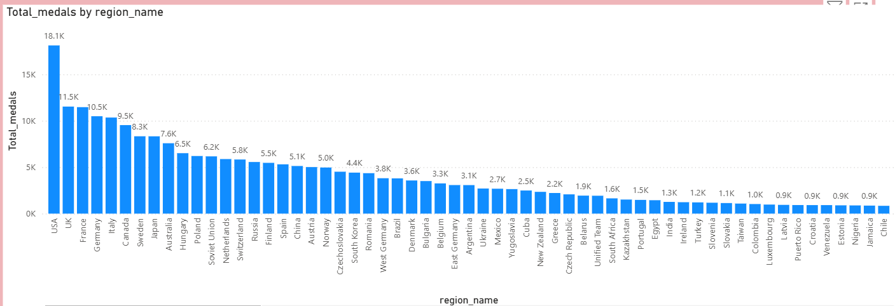
Power BI: Regional Analysis
16. NOCs Per Game: Column chart showing count of region names by Games Name.
17. Highest Participant Regions: USA leads (Table visual sorted descending).
18. Medal Distribution by Region: Column chart visualizing Total Medals by Region Name.

Slide 22
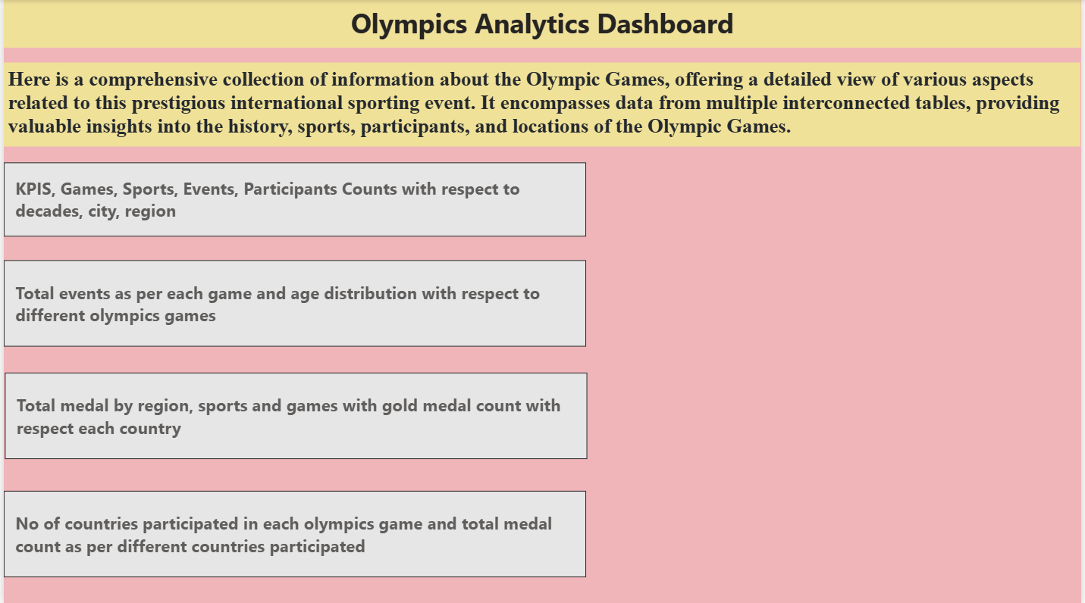

Final Interactive Dashboard Design (Power BI)
• Data Modelling: Managed relationships, made all connections active, enabled bi-directional filtering (Dimension <-> Data Table).
• UI/UX: Title box inserted ('Olympics Analytics Dashboard'), formatted for visual appeal.
• Navigation: 4 action buttons inserted for page navigation. Action set to 'Page navigator' linking to relevant visual pages. Text enabled on buttons for context.
• Alignment: All KPIs, charts, graphs, and trends aligned properly.
• Interactivity: CTRL + Click on buttons navigates to respective dashboard pages seamlessly.

Slide 23
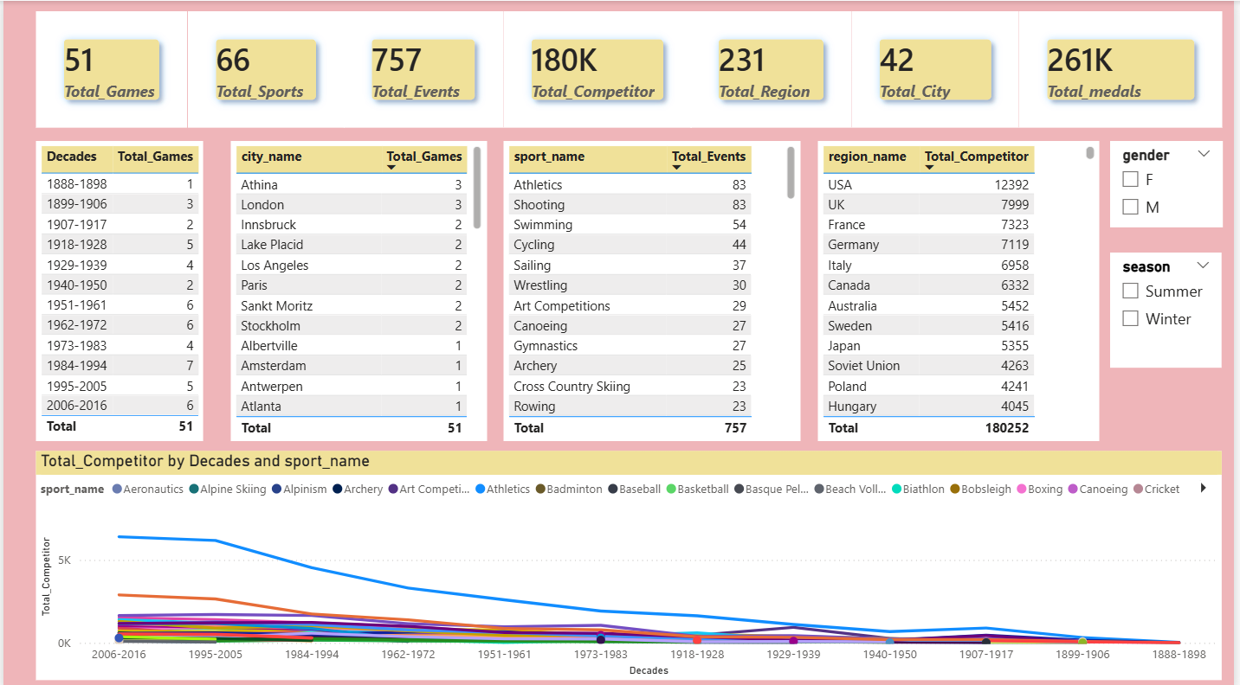
CTRL+1st action button

Slide 24
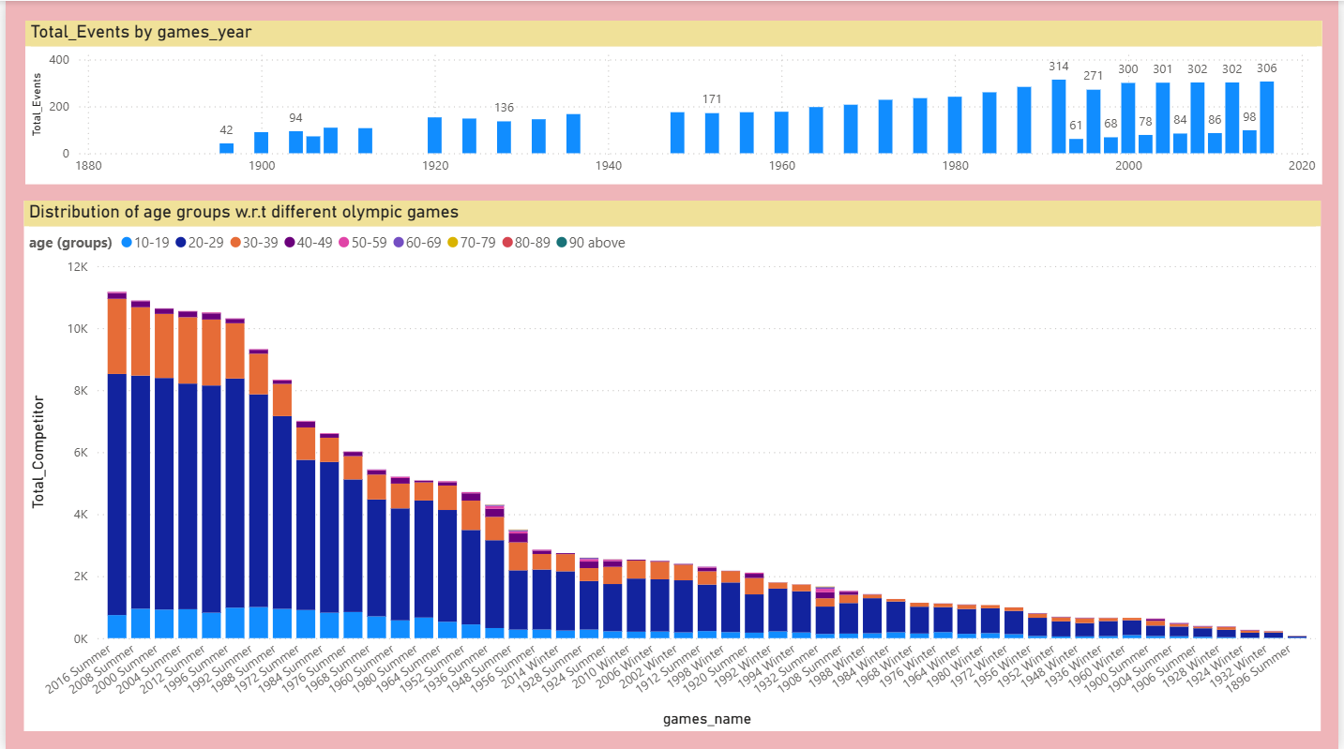
CRTL+2nd action button

Slide 25

CRTL+3rd action button

Slide 26

CTRL+4th action button

Slide 27
Conclusion
• The Olympic Games have evolved significantly in scale, gender inclusion, and global representation.
• Geographical and cultural factors strongly influence sporting dominance (e.g., India in Hockey, Scandinavia in Winter Sports).
• Athlete physical demographics have trended upward, reflecting modern training and nutrition.
• Interactive BI Dashboards allow for seamless, dynamic exploration of these historical trends.

